Slide 1
Progressive Web Apps Around the Globe
Colleen Dunlap

Slide 2



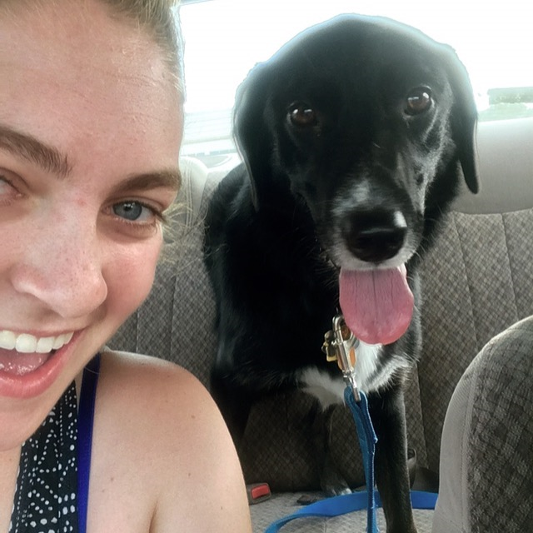
Hi! I’m Colleen (she/hers).

Slide 3
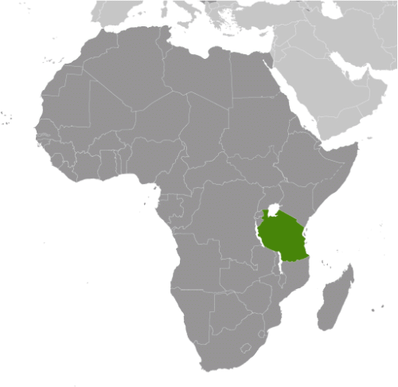



Slide 4
200 million
438,000
2 minutes
Notes:
According to WHO, Every year:
There are 200 million cases of malaria
There are 438,000 deaths from malaria
Every 2 minutes, a child dies from malaria

Slide 5


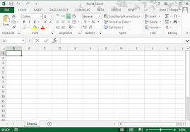

Notes:
Technician Records Data in the field
Technician takes paper forms to office
Data is manually entered into an Excel form

Slide 6

Notes:
Offline Necessary? I guess I’ll make an android app… so not sexy…

Slide 7

Notes:
WRONG! Just make a PWA!

Slide 8
Non-PWA Demo Video => https://drive.google.com/file/d/1JLJbOyHQipVAuF3Rau70VNeijKMCj7jE/view?usp=sharing

Slide 9
PWA Demo Video=> https://drive.google.com/file/d/1LDSKg-vrX1g2TOadCUr9mjS1Zu6PA_9R/view?usp=sharing

Slide 10
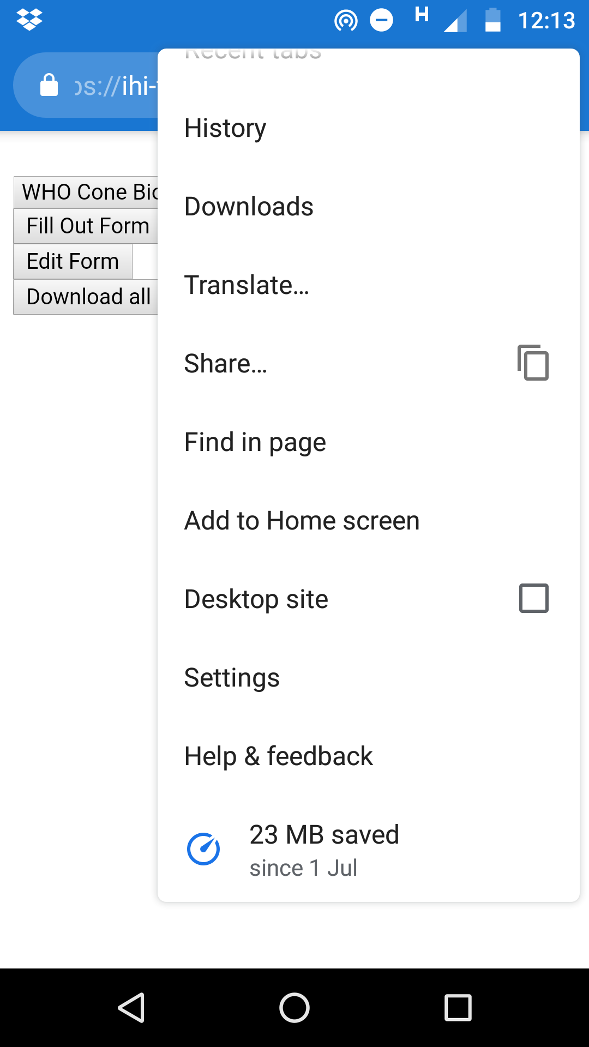
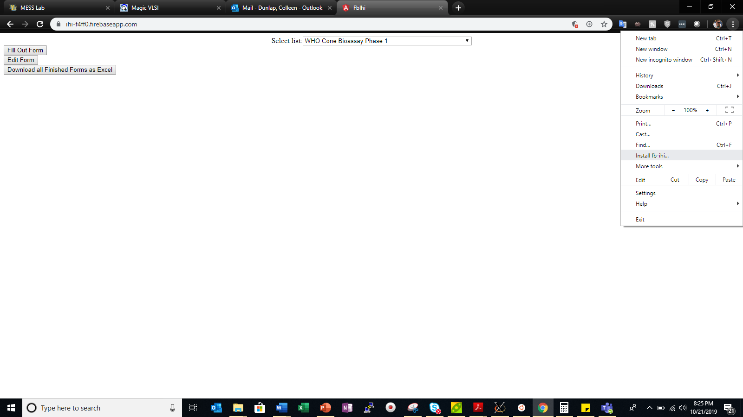

Slide 11
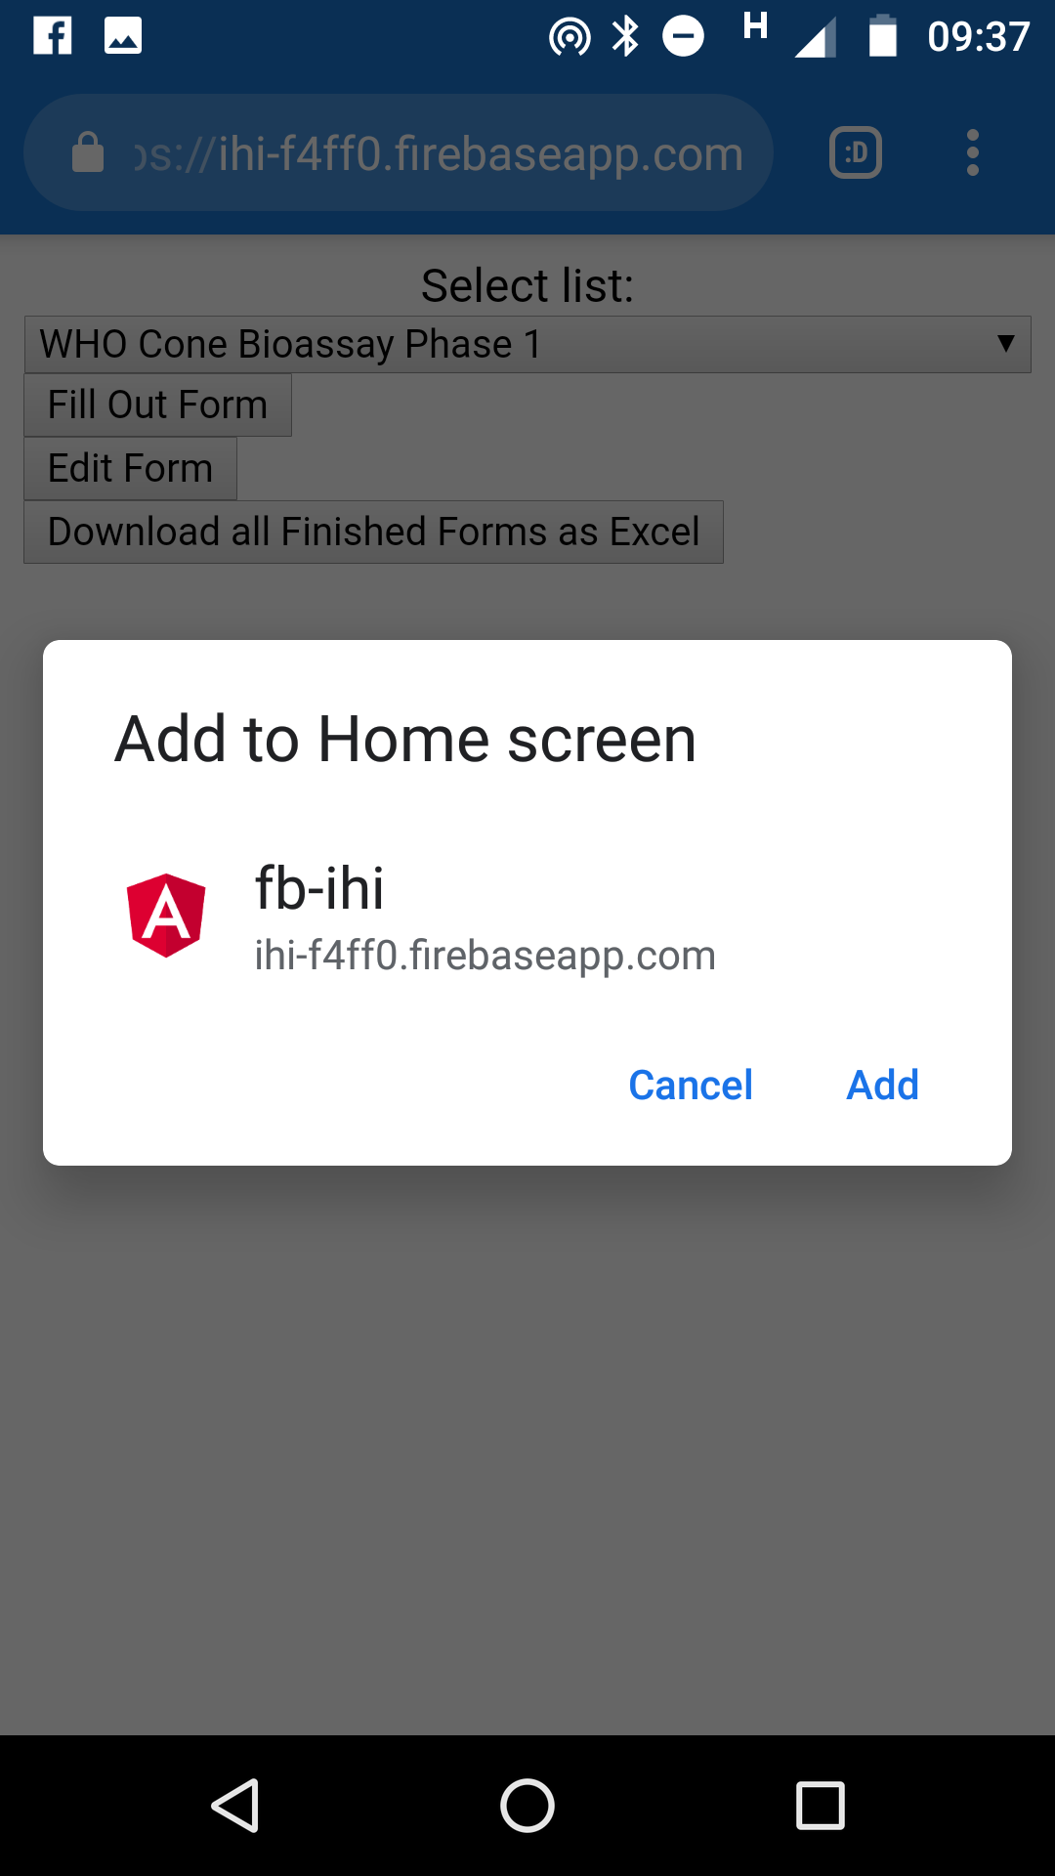
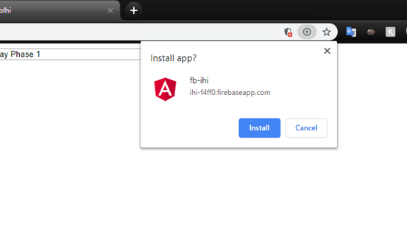

Slide 12
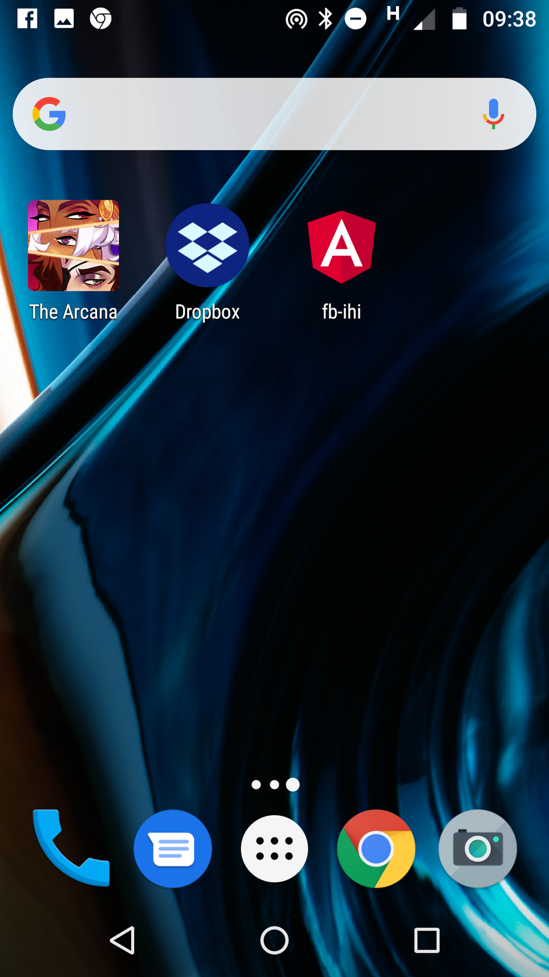
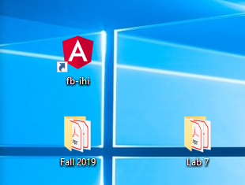

Slide 13
What’s a PWA?
“use modern web APIs along with traditional progressive enhancement strategy to create cross-platform web applications”--MDN
“user experiences that have the reach of the web, and are reliable…fast…engaging”—Google Developers
“regular web pages or websites, but can appear to the user like traditional applications or native mobile applications”—Wikipedia
Notes:
Circa 2015

Slide 14
NOT a Framework NOT a Package NOT a Library IS a Set of Technologies, Tools and Practices

Slide 15
What? How?
Manifest
Typically a JSON file
Service Worker
HTTPS
Lists what Resources your Program Needs to Run
Programmatically Caches Resources
Push Notifications
Otherwise, vulnerable to Man-in-the-Middle Attacks

Slide 16
Link to Poke-Demo Repo => https://github.com/colleenDunlap
Link to Poke-Demo App => https://poke-demo-13875.firebaseapp.com/

Slide 17




Tools
Notes:
Can use any framework! However, I find the easiest combination is the collection above.

Slide 18
ng add @angular/pwa
Notes:
One line to turn your Regular Angular app into a PWA!

Slide 19




Where?
Notes:
Twitter Lite—PWA uses 3% less disk space
Pinterest—PWA increased ad revenue by 44%

Slide 20

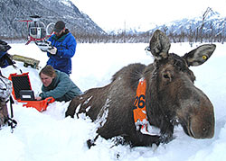
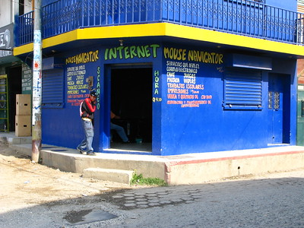

Who Cares?
Notes:
Build technology for people.

Slide 21


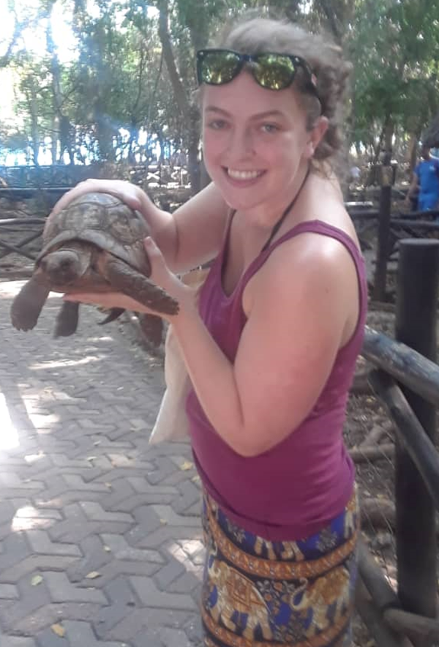
Thank you!
Asante sana!
Email colleen85052@gmail.com
GitHub github.com/colleenDunlap
Twitter @ColleenDHere
LinkedIn lol, just email me

